Slide 1


Slide 2
Marketing Analysis Project
You're a marketing analyst and you've been told by the Chief Marketing Officer that recent marketing campaigns have not been as effective as they were expected to be. You need to analyze the data set to understand this problem and propose data-driven solutions.
The aim of this project is to evaluate how the marketing campaigns are not as effective as they were expected to be and to provide data-driven recommendations/suggestions to the CMO.
Notes:
The focus of this project is to consider why the marketing campaigns were not effective and recommend suggestions to this identified problems.

Slide 3
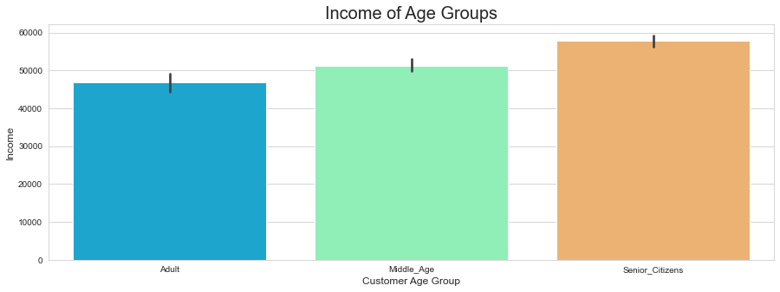
Exploratory Data Analysis on Customer Segmentation
This help to identify this company's profitable customers and tune its offers to increase profitability and also help identify sales opportunities.
The target market Age groups are from 25 to 128, and they have been group into Adult (25 - 40), Middle age (41 - 60) and Senior citizens (61 - 128 years old).
Notes:
The target market Age groups are from 25 to 128, and they have been group into Adult (25 - 40), Middle age (41 - 60) and Senior citizens (61 - 128 years old).
It is important to know the target market to be able to strategically plan effective campaigns that will attract these groups.

Slide 4
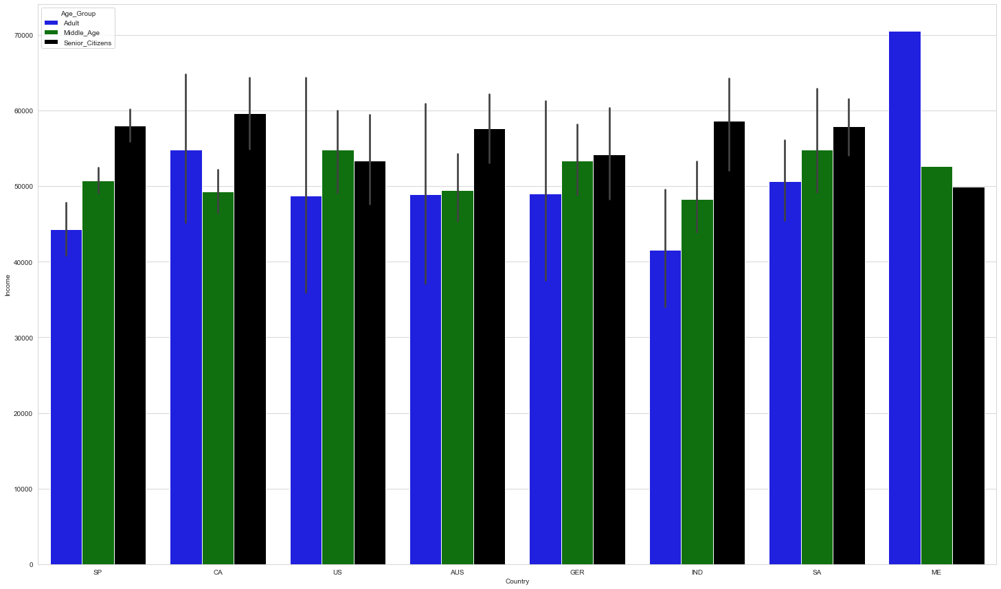
Age group against Income and countries
Evaluating where most of your customers are and their income. Customers in Montenegro are the highest salary earners, most of these customers are the Adults, followed by the Middle_Age and the senior citizens are the lowest earners in this country.
Notes:
Interesting insight; most of these companies, especially the EU senior citizens earns higher salary compared to other age group.

Slide 5
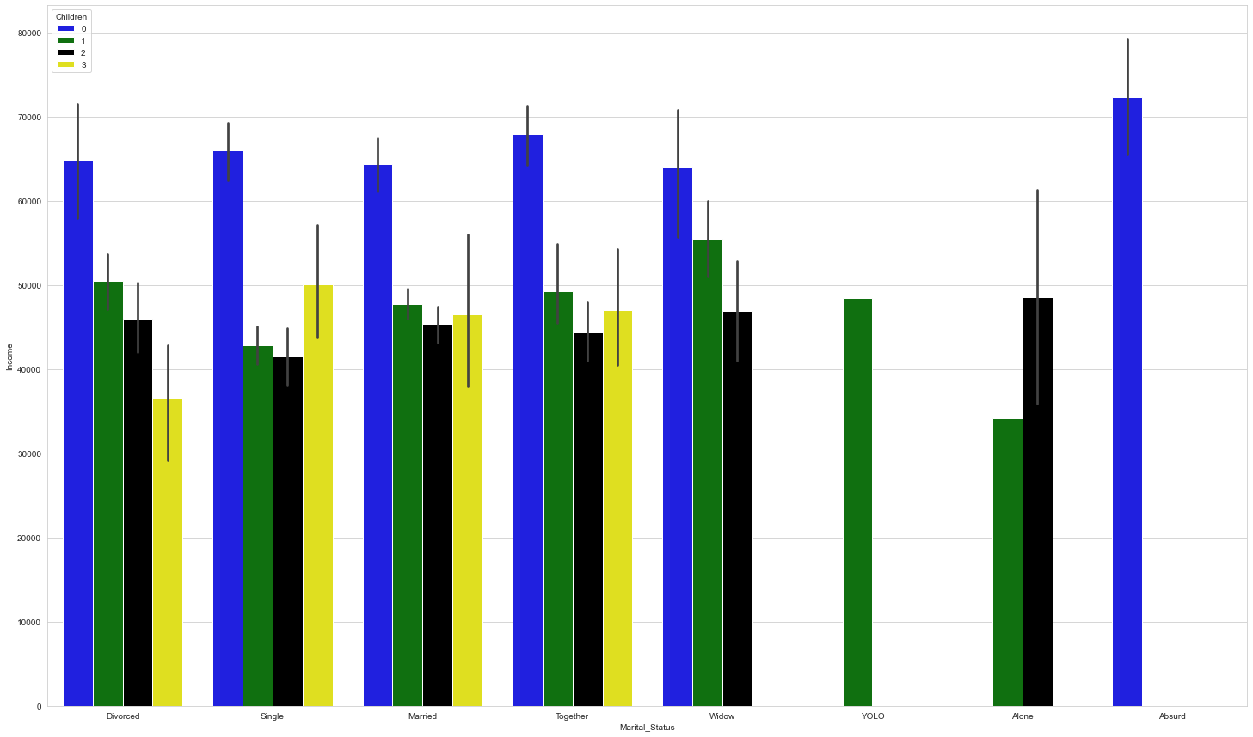
Marital Status against Income
Most of the customers that has no child earns the highest salaries, and the Absurd class that are neither married or divorced are the highest earners and has no child at all.
Notes:
Most of the customers that has no child earns the highest salaries, and the Absurd class that are neither married or divorced are the highest earners and has no child at all.

Slide 6
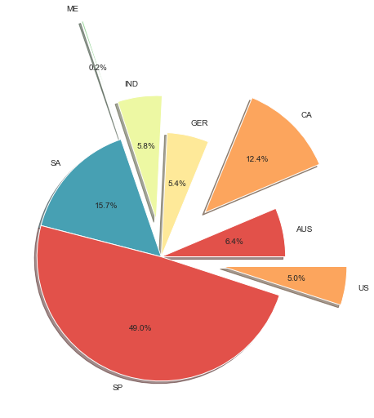
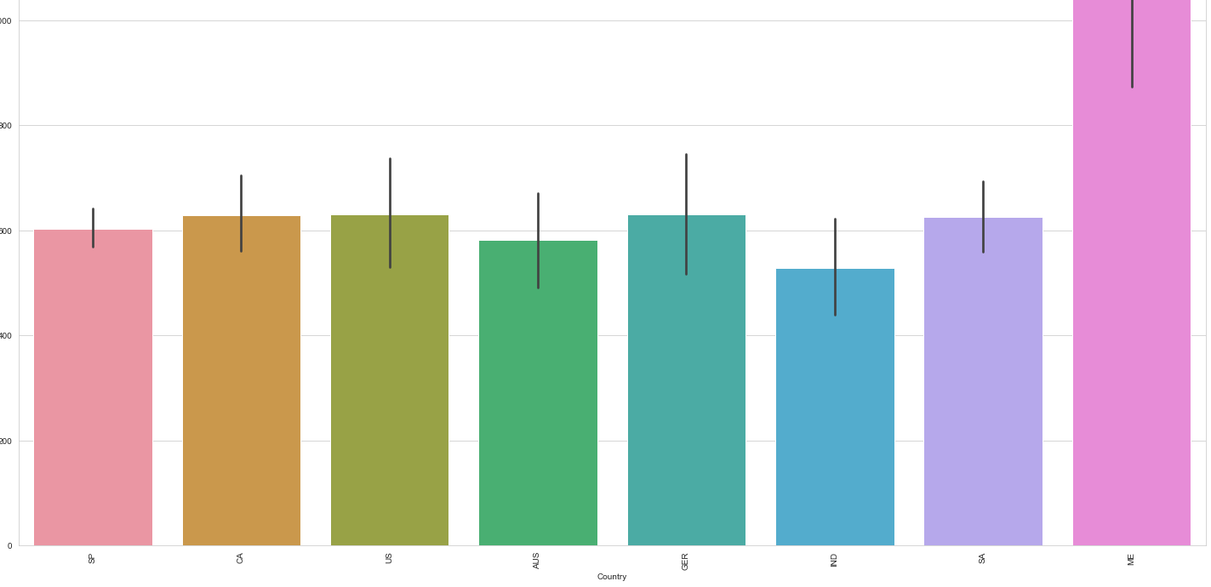
Total Number of customer based on purchases history in countries
Real-time sales analysis - knowing what is bought, by whom, where, how often and when, a business can match supply more accurately with demand and reduce wasted capacity or store.
Notes:
The pie chart shows the total number of customers in each country, Spain has the largest customers with 49%, On the other hand, Montenegro has the highest frequencies of purchases over the last two years. This country has the least customers in the pie chart, but the few customers the country has are loyal to the company and has a healthy and better purchase history over the last two years than other countries.
The marketing analyst should pay more attention to this region and plan targeted campaigns to grow this country for better sales.

Slide 7
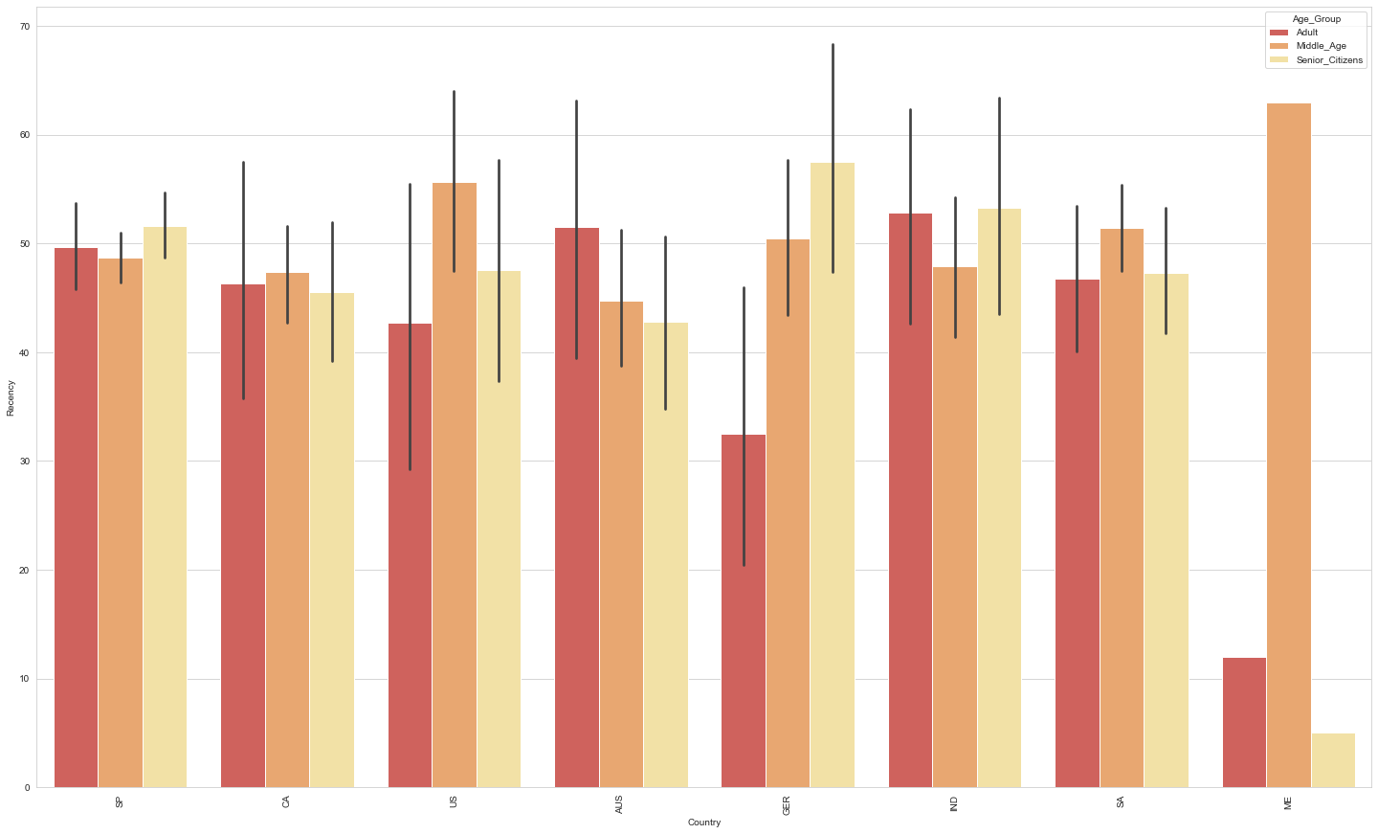
Number of days since customers last purchase based on location
Spain has the highest number of customers for this company, and their last purchased was between 48 - 50 days ago(All the age group in this country has stopped patronising this company).
Montenegro, the best selling country, the Middle Age last purchased was 64 days ago, Adult last purchased was 12 days ago, meaning that this age group is still buying products from this XYZ company till date and the senior age group last purchased was 5 days ago.
Notes:
The marketing Analyst should making findings to know why this best selling country's middle age group has drastically reduced their frequencies of purchases, by making compelling and enriching strategies that will meet the needs of this middle age.

Slide 8
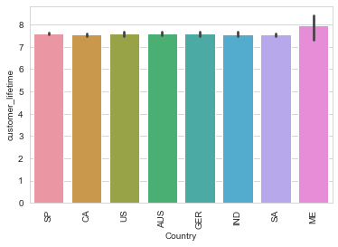
Lifetime value of customers
The average lifetime of customers per country, shows ME has a longer customer retention and brand loyalty as compared to other customers from other countries.
Notes:
The average lifetime of customers per country, shows ME has a longer customer retention and brand loyalty as compared to other customers from other countries.

Slide 9
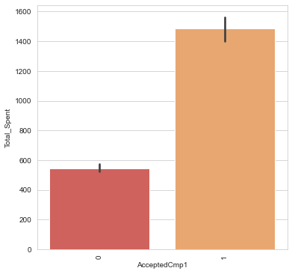
Campaign effectiveness
The first marketing campaign against the total spend in the last two years:
The campaign recorded. Alot of customers did not respond to this campaign, but a few still responded.

Slide 10
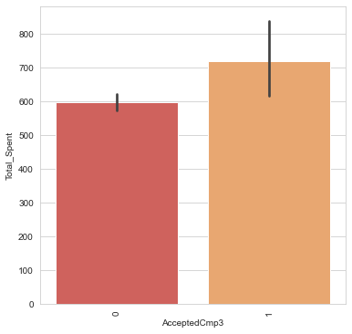
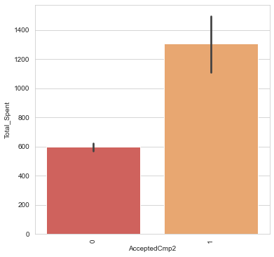
Campaign effectiveness against Total Purchase
Notes:
Each of the campaign recorded little success, the was little sales recorded after each campaign.

Slide 11
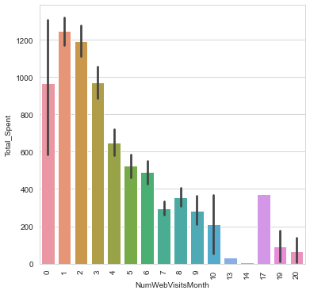
Traffic to the website
The marketing campaign brought little traffic to the website, recording little sales.
Its surprising that little traffic to the website recorded more sales, but as the traffic grew, the sales dropped.

Slide 12
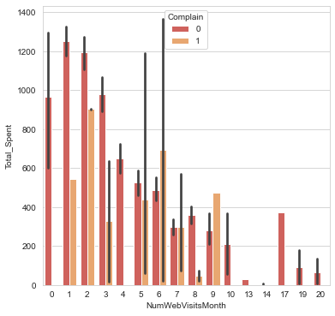
Most of the customers complaint led to decline in sales
Out of curiosity, I want to know why traffic in the website led to decline in sales. Most of the customers complained about the poor services of the XYZ company in the last two years, I believe this was not properly handled, and ofcourse this explained why their numerous campaigns was not as effective as expected.

Slide 13
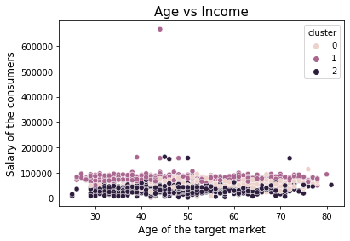
Clustering
Cluster 0: They are the medium salary earners, over $90,000, and a few anomaly earn little above $100, 000.
Cluster 1: They are the highest salary earners, majority of the customers in this cluster earn over $100, 000, and a few anomaly earn almost $200,000, and the richest more than $600, 000.
Cluster 2: They are the lowest salary earners, below $90,000.

Slide 14
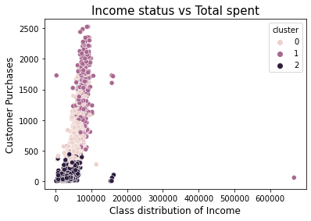
Clustering on Income and Total Purchases
Cluster 0: The medium salary earners, and medium total purchases.
Cluster 1: The highest salary earners, and ofcourse, the highest total purchases was done by this cluster.
cluster 2: The lowest salary earners, and has the lowest total purchases.

Slide 15
Testing the validity of my model using cross validation:
· cv for decision tree is 0.6721948920644574
cv for KNeighborsClassifier is 0.6520171277997365
cv for SVC is 0.648496199452721
cv for LogisticRegression is 0.698517583865409 - The best model to be used for the prediction.

Slide 16
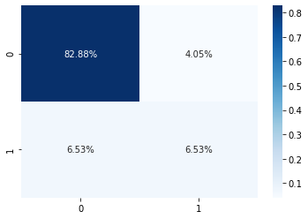
Confusion matrix for logistic Regression:
True negatives - customers that did not respond to the campaign ...82.88%
True positives - customers that responded to the campaign… 6.53%

Slide 17
Test Predictions of my model
Accuracy_score: 0.8941441441441441
Precision_ score: 0.9269521410579346
Recall_ score: 0.9533678756476683
F1_score: 0.9399744572158365
Roc_Auc_score: 0.66839378238343

Slide 18
Observations and recommendations
Observations:
Most are of the target market are married and met graduation as highest education level.
The majority of clients make under $100,000 and over half of them do not have kids or teens at home.
Spain has the largest customers for this XYZ company and the best purchase history based on total purchased is Montenegro

Slide 19
Recommendation:
Customer segmentation:
The company should strategically segment their market to identify their target consumer, also, some countries like Spain had more consumer for this brand, but Montenegro had the least consumers and this country generates more sales for the last two years compared to other countries.
The company should focus more in Montenegro marketing.

Slide 20
Recommendations:
Give the campaign enough time
The campaign was not given enough time to be effective, several campaigns were executed when the previous ones were not successful. When you don’t get the results you want from a marketing campaign it can be disheartening, to say the least. And the last thing you want to do is sink more time and money into a failing campaign. But at the same time, you need to ensure you give your marketing campaign enough time to succeed. The best way to do this is to set goals and timelines before the campaign launch.

Slide 21
Recommendations
The Product/Services Fell Short of its Claims
From the high number of customers complaint, the customers were disappointed at the company’s performances. As great as the marketing campaigns were which led to website traffic, , the consumers were disappointed in its performances and word of mouth spreads quickly, this led to sales decline. Customers feedback and complaints should be well handled to solve any challenge the customers are experiencing the the product or services.

Slide 22
Recommendations
Finally, have correct or realistic success metrics:
The campaigns did not have correct or realistic success metrics, it appeared as though the campaign was a total failure, but it was not as bad as they thought. For instance, the number of customers who visited the brand website was on the increase and more customers also made purchases directly in stores.Therefore, the company should look at all of the metrics of success before they launch a campaign and come up with realistic, attainable goals for marketing campaign.

